Slide 1
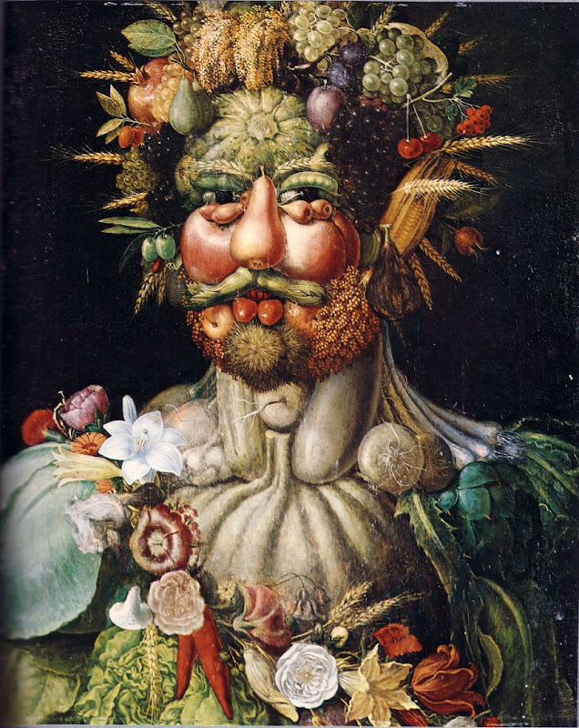
Guiseppe Arcimboldo

Slide 2
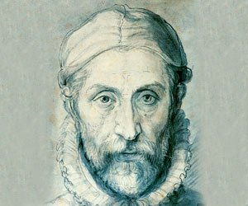
Biography
Guiseppe was born in 1527 in Milan, Italy.
He was most well known as a mannerist which means one who portrays a close relationship between human and nature. Guiseppe was most well known for painting portraits out of fruits, vegetables, flowers, fish and roots. He was 66 years old when he died on July 11, 1593.

Slide 3
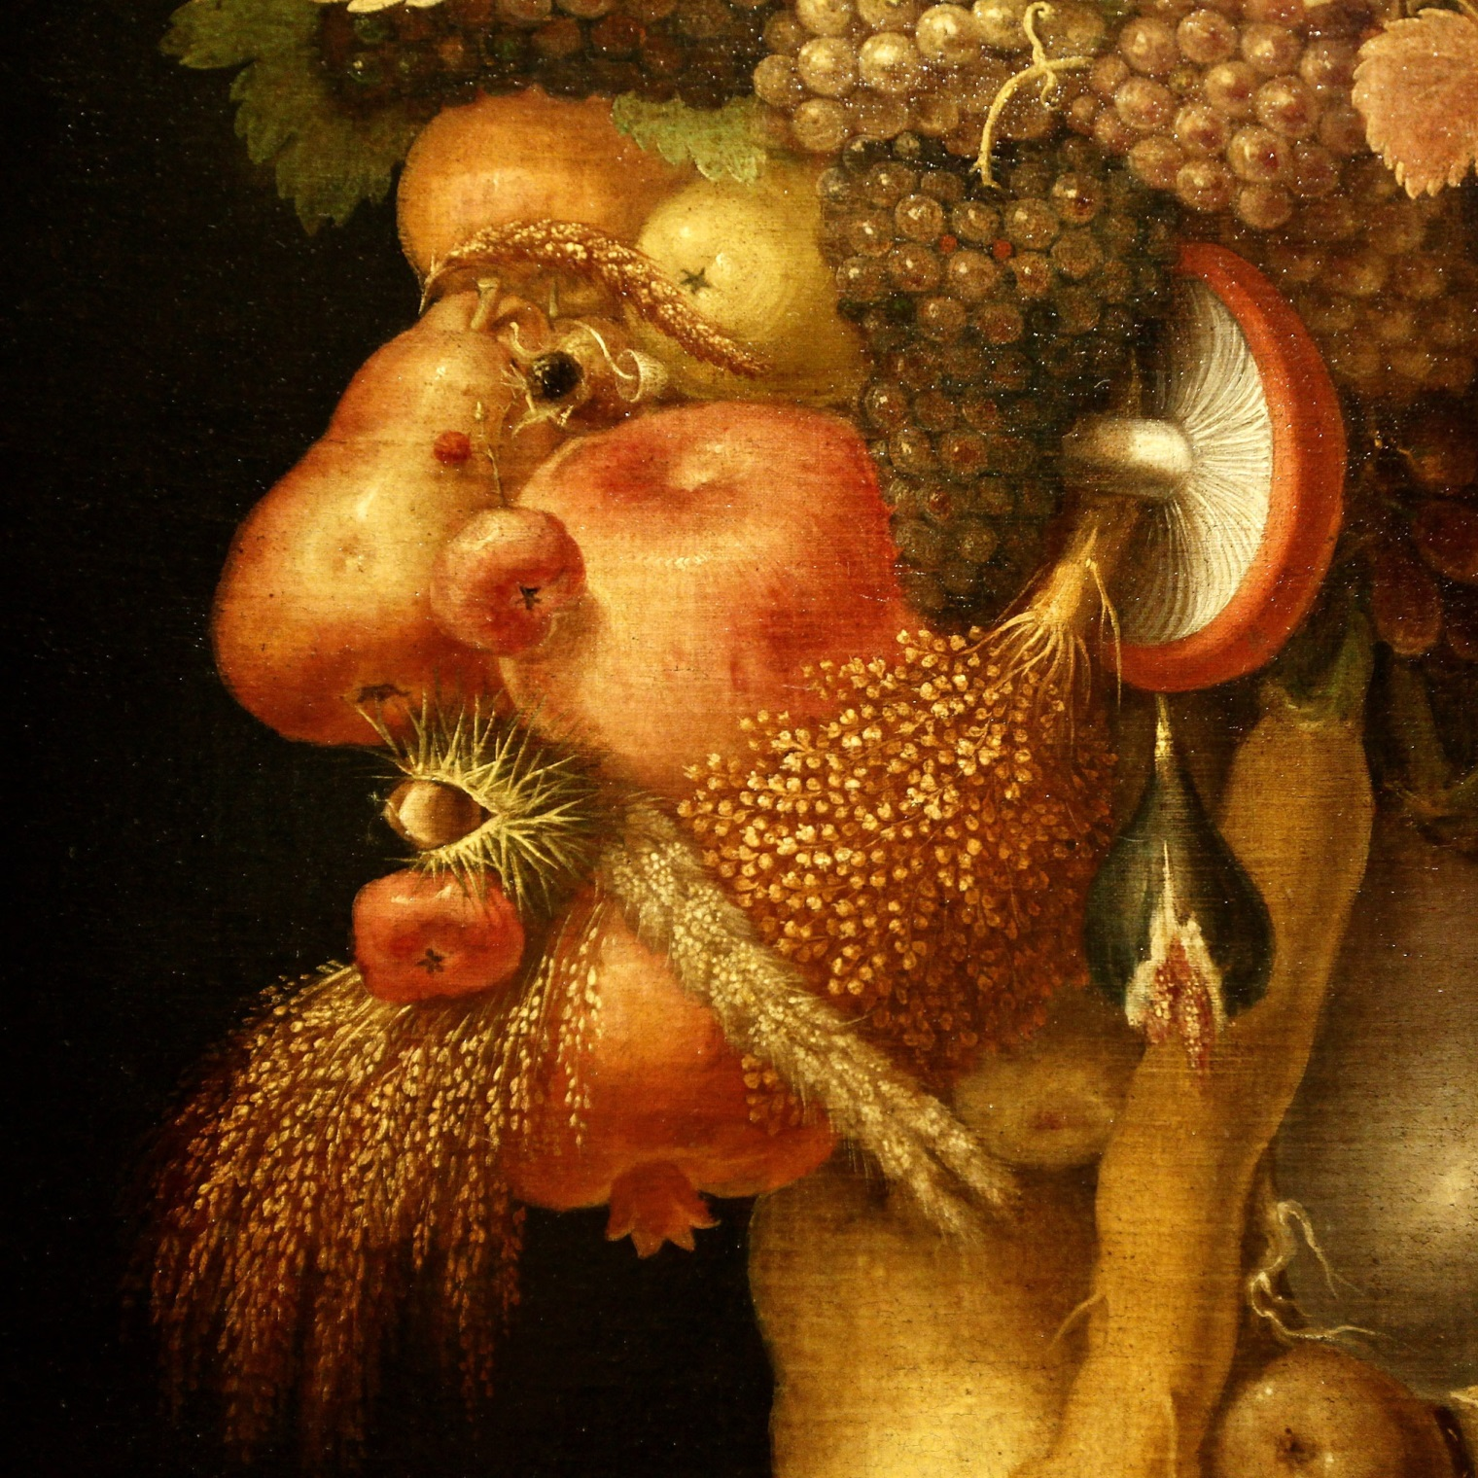
What do you notice about guiseppe’s paintings?

Slide 4
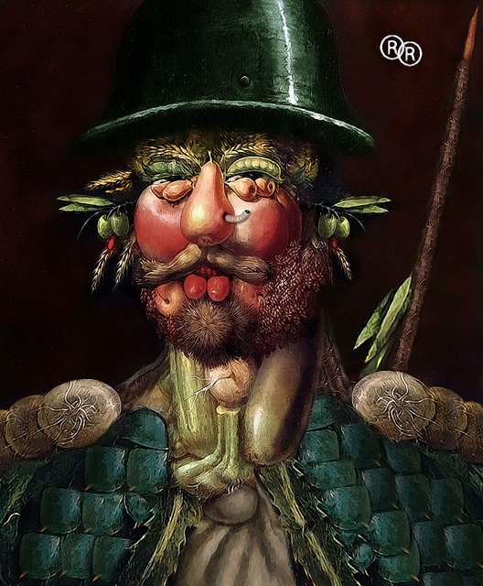
What do you like about Guiseppe’s paintings?

Slide 5
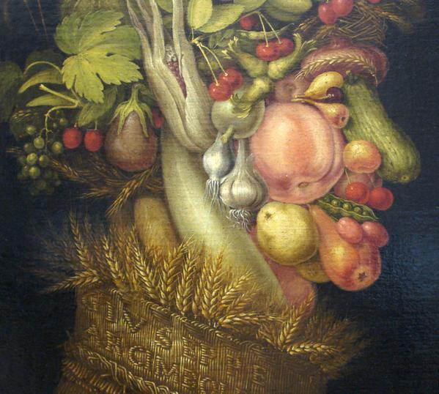

Slide 6
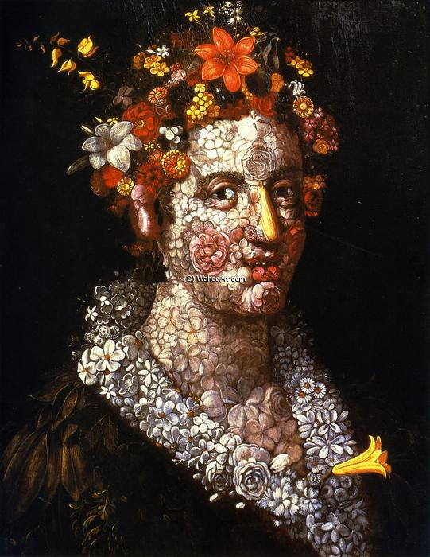

Slide 7
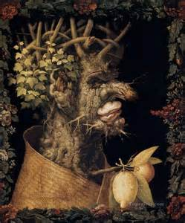
1.1c Describe and analyze artistic intent using information about the culture, time in which the work was created and the artist 2.2a identify and explain how the characteristics and expressive features of art and design are used in works of art 4.2b Recognize the characteristics and expressive features of art and design through various historical periods and cultures

